Slide 1
ILO strategy on skills and lifelong learning (LLL) 2030
Ashwani Aggarwal, Ph.D.
Workgroup Lead (Skills Policy, Systems and Digitalization)
International Labour Organization, Switzerland
aggarwal@ilo.org

Slide 2
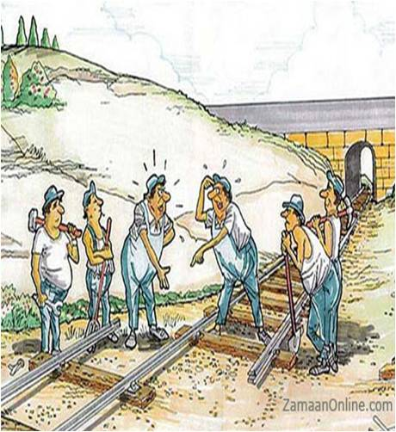
Mismatch between skill supply and demand continues to be a challenge
205 Million
People worldwide are unemployed,
23.5%
youth (aged 15-24) are NEET
Of employers globally report difficulty finding the skilled talent they need in 2023
77%
Sources: ILO 2023; Manpower Group 2023; U.S. Bureau of Labour Statistics, 2021; Deloitte, 2017; IBM 2019
Notes:
Talking points for this slide:
Why is a new strategy on skills and lifelong learning needed?
Skills mismatch: There is a high demand for jobs (first data on unemployment and discouraged workers), highly untapped potential of youth which is completely idle (NEET), and at the same time supply of jobs (employers) cannot find the skills they need -> Clearly absurd situation in which there is a need to restructure both skill demand (employers’ side) and supply (workers’ side).
Need for continuous learning:
The stereotypical and traditional idea of one education, for one job, for one life is clearly outdated and only a myth by now. Already those approaching retirement now (baby boomers) held more than 12 jobs throughout their working life (data available only for US). At the same time, the length of the working life is already expanding (general trend to postpone retirement age or even remove it) and it is likely to increase significantly for the generations entering the labour market now or in recent years due to significantly longer life expectancy. On top of this, the period for which a certain skill remain relevant within the job market is shrinking, even more so for technical skills. Therefore, the scenario is one in which people hold numerous careers within their increasingly longer working lives, characterized by fast-paced need for upskilling. People will need to continuously re- and up-skill to remain competitive in the job market. No linear model of education to work to retirement but a blended mode in which working and learning are never separated and workers undertake numerous rounds of learning and working throughout their expanded working life.
Definitions for the slide:
Global jobs gap: this measure includes people who want employment but are not actively searching for a job, either because they are discouraged or because they have other obligations such as care responsibilities.
NEET: Not in Employment, Education or Training
The cited study by the US Bureau of Labour Statistics show that workers born between 1957 – 1964 held an average of 12.4 jobs from ages 18 to 54.
Up to 60-70 years of career: In the widely debated and award-winning book “The 100-Year Life: Living and Working in an Age of Longevity” – on which the quoted Deloitte source builds on -, Lynda Gratton and Andrew Scott argue that, since the life expectancy for youth born after 1997 in rich countries exceeds 100 years, it is hardly imaginable to continue retiring at the age our parents did (circa 65) -> Longer working lives. This also means that receiving only education once in a lifetime, as in traditional life models, is highly unlikely to be realistic. This connects to the following point.
5 years: Estimated half-life of a learned skill: the time by which the skill becomes obsolete. Therefore, continuous training and LLL becomes essential to support longer careers with skills becoming rapidly obsolete and generating continuous need for updates
The Fourth Industrial Revolution is creating demand for millions of new jobs, with vast opportunities for fulfilling people’s aspirations and potential. Yet, at present, the dominant trend and narrative remains one of unequal opportunity, job displacement and widening inequality. In the job market, half the global labour force might need reskilling by 2025. In schools, if current trends continue, many students will continue to lack the skills necessary to thrive in the future of work. With societal unrest on the rise across much of the industrialized and emerging world, labour markets in flux from the fallout of the pandemic, technological disruption and the green transition, collaboration between the public and private sectors can advance an entirely different agenda, where people’s futures and global economic prospects are enhanced by mobilizing worldwide mass action on reskilling, upskilling and education transformation. (WEF)

Slide 3
Why is a new strategy on skills and lifelong learning needed?
Need for continuous learning
12.4 jobs
Average number of jobs baby boomer had in their working life in the U.S., highly likely to increase for younger generations
40 years
Up to 60 – 70 years
Increasing longevity: Likely increase in working life for new generations
10 – 15 years
5 years
Decreasing longevity of skills
44% of workers’ core skills will change in 5 years (WEF).
Sources: ILO 2023; Manpower Group 2023; U.S. Bureau of Labour Statistics, 2021; Deloitte, 2017; IBM 2019; WEF
Notes:
Talking points for this slide:
Why is a new strategy on skills and lifelong learning needed?
Skills mismatch: There is a high demand for jobs (first data on unemployment and discouraged workers), highly untapped potential of youth which is completely idle (NEET), and at the same time supply of jobs (employers) cannot find the skills they need -> Clearly absurd situation in which there is a need to restructure both skill demand (employers’ side) and supply (workers’ side).
Need for continuous learning:
The stereotypical and traditional idea of one education, for one job, for one life is clearly outdated and only a myth by now. Already those approaching retirement now (baby boomers) held more than 12 jobs throughout their working life (data available only for US). At the same time, the length of the working life is already expanding (general trend to postpone retirement age or even remove it) and it is likely to increase significantly for the generations entering the labour market now or in recent years due to significantly longer life expectancy. On top of this, the period for which a certain skill remain relevant within the job market is shrinking, even more so for technical skills. Therefore, the scenario is one in which people hold numerous careers within their increasingly longer working lives, characterized by fast-paced need for upskilling. People will need to continuously re- and up-skill to remain competitive in the job market. No linear model of education to work to retirement but a blended mode in which working and learning are never separated and workers undertake numerous rounds of learning and working throughout their expanded working life.
Definitions for the slide:
Global jobs gap: this measure includes people who want employment but are not actively searching for a job, either because they are discouraged or because they have other obligations such as care responsibilities.
NEET: Not in Employment, Education or Training
The cited study by the US Bureau of Labour Statistics show that workers born between 1957 – 1964 held an average of 12.4 jobs from ages 18 to 54.
Up to 60-70 years of career: In the widely debated and award-winning book “The 100-Year Life: Living and Working in an Age of Longevity” – on which the quoted Deloitte source builds on -, Lynda Gratton and Andrew Scott argue that, since the life expectancy for youth born after 1997 in rich countries exceeds 100 years, it is hardly imaginable to continue retiring at the age our parents did (circa 65) -> Longer working lives. This also means that receiving only education once in a lifetime, as in traditional life models, is highly unlikely to be realistic. This connects to the following point.
5 years: Estimated half-life of a learned skill: the time by which the skill becomes obsolete. Therefore, continuous training and LLL becomes essential to support longer careers with skills becoming rapidly obsolete and generating continuous need for updates
The Fourth Industrial Revolution is creating demand for millions of new jobs, with vast opportunities for fulfilling people’s aspirations and potential. Yet, at present, the dominant trend and narrative remains one of unequal opportunity, job displacement and widening inequality. In the job market, half the global labour force might need reskilling by 2025. In schools, if current trends continue, many students will continue to lack the skills necessary to thrive in the future of work. With societal unrest on the rise across much of the industrialized and emerging world, labour markets in flux from the fallout of the pandemic, technological disruption and the green transition, collaboration between the public and private sectors can advance an entirely different agenda, where people’s futures and global economic prospects are enhanced by mobilizing worldwide mass action on reskilling, upskilling and education transformation. (WEF)

Slide 4
Governments & social partners led the development of the ILO Strategy on Skills and LLL 2030
ILO Centenary Declaration for the Future of Work emphasised the need for LLL
International Labour Conference developed a Resolution & Conclusions on Skills and LLL in 2021
The Office drafted a strategy based on the Conclusions
ILO GB adopted it in 2022

Slide 5
Theory of change How improved skill systems can contribute to sustainable development
Transformations needed in skills systems to address the challenges
representing short- to medium-term outcomes
5 pillars

Slide 6
5 pillars
for an effective, responsive & efficient Skills System
Improved policies, governance and financing
Strengthened skills needs intelligence
Innovative, flexible learning programs
& pathways
Inclusive skills programs
Quality
apprenticeship
& WBL

Slide 7
Theory of change How enhanced skill systems can contribute to sustainable development
Transformations needed in skills systems to address the challenges
ILO action plan to support constituents
5 interrelated and mutually reinforcing components
representing short- to medium-term outcomes
5 pillars

Slide 8
The ILO Action Plan 5 interrelated and mutually reinforcing components
Policy advice, capacity development & technical support
Partnerships
Research, knowledge management & dissemination
Normative standards
Resource mobilisation

Slide 9
Theory of change How enhanced skill systems can contribute to sustainable development
Transformations needed in skills systems to address the challenges
The action plan to support constituents
Targeted socioeconomic impacts
5 components
-interrelated and mutually reinforcing
5 objectives
- for LM & society and contribution to the SDGs
5 pillars
-representing short- to medium-term outcomes

Slide 10
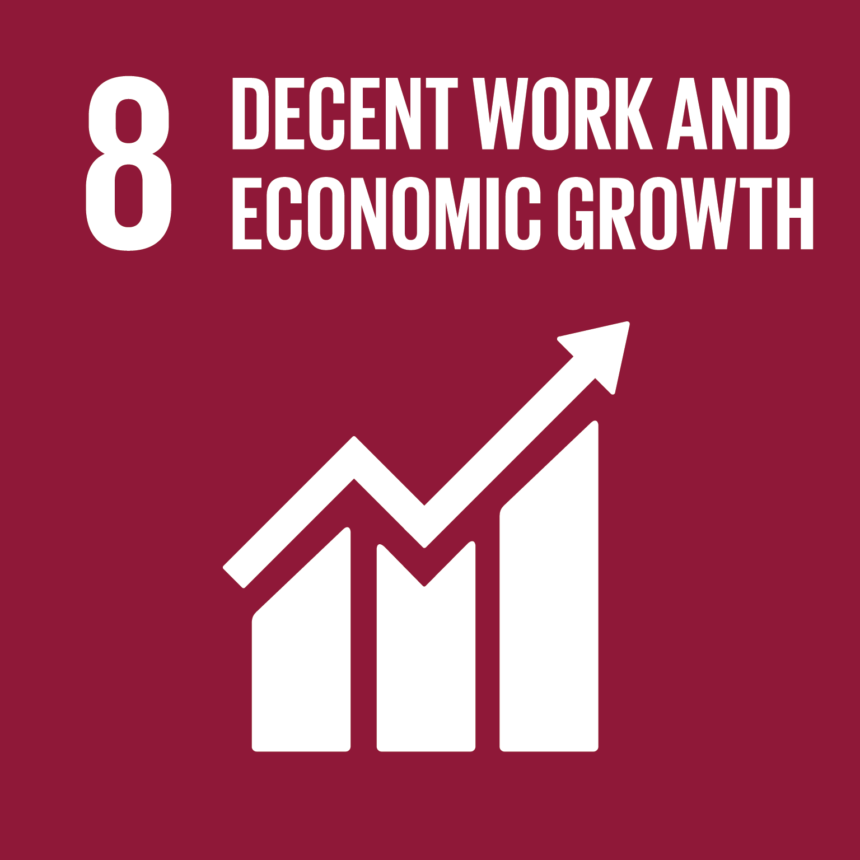
5 Objectives
What is the change we want to see?
Successful individual transitions to and within labour markets
To contribute to the achievement of SDGs
Gender sensitive and inclusive approach to LLL and labour markets
Inclusive, resilient and sustainable economies & societies
Just transition to Digital and Green economies
Improved productivity & competitiveness of enterprises
Notes:
With your support and collaboration, the Programmes’ goals are to enable: (1) successful individual transitions to and between decent jobs; (2) improved competitiveness of enterprises, (3) just transition to green and digital economies and (4) inclusive and peaceful societies.
As such, the programme will contribute to the achievement of SDGs 4, 8 and 17.

Slide 11
Ashwani Aggarwal
Workgroup Leader (Skills Policy, Systems and Digitalization)
International Labour Organization, Switzerland
aggarwal@ilo.org
For more information, please visit www.ilo.org/skills

